Slide 1


Machine Learning LAB
Ensemble Models

Slide 2
WHAT IS ENSEMBLE LEARNING
Train several models on the same task and combine their predictions
The combined answer is often better than the best single model
Wisdom of the crowd: ask many people and average the answers
Works for classification, regression and anomaly detection
Random forest is already an ensemble of decision trees
Model 1: UP
Combine (vote or average)
Final: UP
Model 2: UP
Model 3: DOWN
Majority vote of three classifiers

Slide 3
THREE GROUPS OF ENSEMBLES
Averaging methods
Boosting methods
Stacking
Voting, bagging, random forests, extra trees
Models are trained independently
Predictions are voted or averaged
Gradient Boosting, AdaBoost, XGBoost
Models are trained one after another
Each model focuses on the mistakes of the previous ones
Several different models make predictions
A final model learns how to combine them
The final model is trained on their predictions
Most of these are in scikit-learn. XGBoost is a separate package, and stacking is available as StackingClassifier.

Slide 4
IMPORTS
import numpy as np
import pandas as pd
import seaborn as sns
import sklearn
import matplotlib.pyplot as plt
%matplotlib inline
import warnings
warnings.filterwarnings('ignore')

Slide 5
ELECTRICITY DATASET
45,312
instances
8
features
2
classes: UP, DOWN
Source: OpenML electricity (id 151), New South Wales electricity market in Australia
Each row is a 30-minute period, so there are 48 rows per day
Dates run from 7 May 1996 to 5 December 1998
Target: did the price go UP or DOWN compared with the moving average of the last 24 hours

Slide 6
DATASET FEATURES
Feature | Meaning
date | Date from 7 May 1996 to 5 December 1998,
day | Day of the week, 1 to 7 (Monday to Sunday)
period | Half-hour slot of the day, 1 to 48
nswprice | New South Wales electricity price, scaled
nswdemand | New South Wales electricity demand, scaled
vicprice | Victoria electricity price, scaled
vicdemand | Victoria electricity demand, scaled
transfer | Scheduled electricity transfer between the two states, scaled
class | Target: price goes UP or DOWN

Slide 7
LOADING THE DATA
from sklearn.datasets import fetch_openml
elec_data = fetch_openml(name='electricity', version=1)
elec_df = elec_data.frame
print("Data shape:", elec_data.data.shape)
print("Feature names:", elec_data.feature_names)
print("Target names:", elec_data.target_names)
Data shape: (45312, 8)
Feature names: ['date', 'day', 'period', 'nswprice', 'nswdemand', 'vicprice', 'vicdemand', 'transfer']
Target names: ['class']

Slide 8
SPLITTING THE DATA
from sklearn.model_selection import train_test_split
train_data, test_data = train_test_split(
elec_df, test_size=0.25, random_state=20
)
print("Training samples:", len(train_data))
print("Testing samples:", len(test_data))
Training samples: 33984
Testing samples: 11328
We split before exploring, so the test set stays untouched until the final evaluation.

Slide 9
QUICK LOOK AT THE DATA
train_data.head(10)
 | date | day | period | nswprice | nswdemand | vicprice | vicdemand | transfer | class
27325 | 0.469846 | 4 | 0.276596 | 0.164705 | 0.519637 | 0.011417 | 0.657949 | 0.265789 | DOWN
28731 | 0.474227 | 5 | 0.574468 | 0.024919 | 0.191907 | 0.001656 | 0.090886 | 0.819737 | DOWN
8450 | 0.023141 | 3 | 0.042553 | 0.065270 | 0.250074 | 0.003467 | 0.422915 | 0.414912 | DOWN
36659 | 0.889385 | 2 | 0.744681 | 0.148193 | 0.670039 | 0.009981 | 0.533402 | 0.563596 | UP
781 | 0.000708 | 4 | 0.276596 | 0.124204 | 0.475454 | 0.003467 | 0.422915 | 0.414912 | UP
13013 | 0.428963 | 7 | 0.106383 | 0.055242 | 0.084647 | 0.003467 | 0.422915 | 0.414912 | DOWN
3330 | 0.009203 | 1 | 0.382979 | 0.045635 | 0.741892 | 0.003467 | 0.422915 | 0.414912 | DOWN
18851 | 0.446662 | 2 | 0.744681 | 0.183409 | 0.785034 | 0.012154 | 0.757639 | 0.517105 | UP
14838 | 0.433830 | 3 | 0.127660 | 0.047886 | 0.141476 | 0.003467 | 0.422915 | 0.414912 | DOWN
30462 | 0.868236 | 6 | 0.638298 | 0.030833 | 0.702023 | 0.001963 | 0.538322 | 0.674123 | UP

Slide 10
DATASET INFORMATION
train_data.info()
<class 'pandas.core.frame.DataFrame'>
Int64Index: 33984 entries, 27325 to 27098
Data columns (total 9 columns):
# Column Non-Null Count Dtype
--- ------ -------------- -----
0 date 33984 non-null float64
1 day 33984 non-null category
2 period 33984 non-null float64
3 nswprice 33984 non-null float64
4 nswdemand 33984 non-null float64
5 vicprice 33984 non-null float64
6 vicdemand 33984 non-null float64
7 transfer 33984 non-null float64
8 class 33984 non-null category
dtypes: category(2), float64(7)
memory usage: 2.1 MB
class is categorical, so it must be encoded
All numerical features are already scaled to the range 0 to 1
day is stored as a category and is not scaled

Slide 11
SUMMARY STATISTICS
train_data.describe()
 | date | period | nswprice | nswdemand | vicprice | vicdemand | transfer
count | 33984.000000 | 33984.000000 | 33984.000000 | 33984.000000 | 33984.000000 | 33984.000000 | 33984.000000
mean | 0.498150 | 0.499211 | 0.057922 | 0.424763 | 0.003445 | 0.423035 | 0.500089
std | 0.340429 | 0.294571 | 0.040195 | 0.163858 | 0.008846 | 0.121087 | 0.153224
min | 0.000000 | 0.000000 | 0.000000 | 0.001190 | 0.000000 | 0.000000 | 0.000000
25% | 0.031857 | 0.234043 | 0.035247 | 0.307944 | 0.002283 | 0.372087 | 0.414912
50% | 0.456307 | 0.489362 | 0.048667 | 0.442725 | 0.003467 | 0.422915 | 0.414912
75% | 0.880581 | 0.744681 | 0.074276 | 0.535704 | 0.003467 | 0.469446 | 0.605263
max | 1.000000 | 1.000000 | 0.981806 | 1.000000 | 1.000000 | 1.000000 | 1.000000
nswprice and vicprice are very skewed: medians of 0.049 and 0.003, but maximums of 0.98 and 1.0.

Slide 12
MISSING VALUES
train_data.isnull().sum()
date 0
day 0
period 0
nswprice 0
nswdemand 0
vicprice 0
vicdemand 0
transfer 0
class 0
dtype: int64
If values were missing, you could:
Remove the rows (you lose data)
Leave them as they are
Fill them with the mean, median or most frequent value (you add some noise)
No option is always best. It depends on the data size and the goal.

Slide 13
CORRELATION HEATMAP
corr = train_data.corr(numeric_only=True)
plt.figure(figsize=(12, 7))
sns.heatmap(corr, annot=True, cmap='crest')
plt.show()

Slide 14
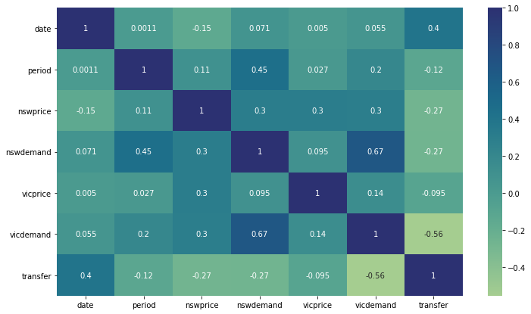
FEATURE CORRELATION
No pair of features is strongly correlated
Strongest pairs: nswdemand and vicdemand (0.67), vicdemand and transfer (−0.56)
Values near +1 or −1 mean two features carry similar information
class is missing because it is still text

Slide 15
CLASS DISTRIBUTION
plt.figure(figsize=(12, 7))
sns.countplot(data=train_data, x='class')
plt.show()

Slide 16
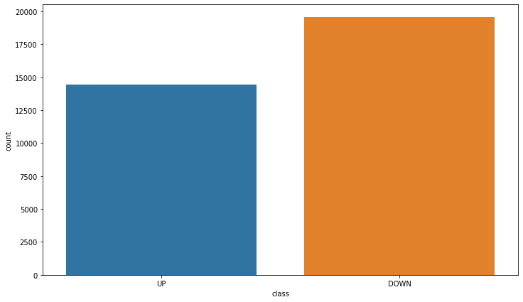
UP VERSUS DOWN
DOWN is more common than UP
Roughly 19,500 DOWN rows against 14,500 UP rows in the training data
The classes are mildly imbalanced, so accuracy alone can hide a bias toward DOWN

Slide 17
CLASS BY DAY OF WEEK
plt.figure(figsize=(13, 8))
sns.countplot(data=train_data, x='day', hue='class')
plt.show()

Slide 18
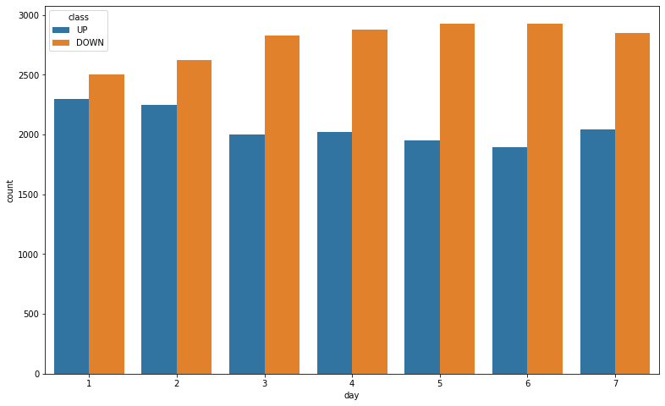
UP AND DOWN PER DAY
DOWN outnumbers UP on every day
The gap is small on day 1 (Monday) and widest on days 5 and 6
day carries some information about the class

Slide 19
FEATURE HISTOGRAMS
train_data.hist(bins=50, figsize=(15, 10))
plt.show()

Slide 20
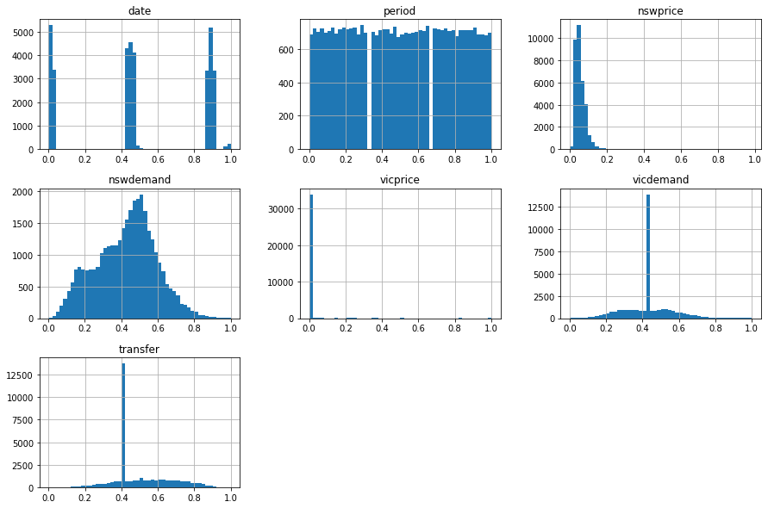
HISTOGRAMS
nswprice and vicprice are concentrated near 0
vicdemand and transfer have a large spike at one repeated value
nswdemand is roughly bell shaped, and period is uniform
date shows three separate clusters

Slide 21
PREPROCESSING
from sklearn.preprocessing import LabelEncoder
X_train = train_data.drop('class', axis=1)
y_train = train_data['class']
label_enc = LabelEncoder()
y_train_prepared = label_enc.fit_transform(y_train)
print(label_enc.classes_)
['DOWN' 'UP']
DOWN becomes 0 and UP becomes 1. Tree based models do not need feature scaling, so day is left as it is.

Slide 22
ACCURACY HELPER
from sklearn.metrics import accuracy_score
def accuracy(model, data, labels):
predictions = model.predict(data)
acc = accuracy_score(labels, predictions)
return acc
We reuse this small function to score every ensemble below.

Slide 23
VOTING CLASSIFIER
Hard voting
Soft voting
Each model predicts a class label
The majority label wins
Example: UP, UP, DOWN gives UP
Average the predicted class probabilities
The class with the highest average wins
Example: P(UP) = 0.55, 0.55, 0.05 averages 0.38, so DOWN
Soft voting needs models with predict_proba. For SVC, set probability=True.
Different model types make different mistakes, which is why voting can help

Slide 24

VOTING CODE
from sklearn.ensemble import VotingClassifier, RandomForestClassifier
from sklearn.linear_model import LogisticRegression
from sklearn.svm import SVC
# day is a category of strings, so we make a numeric copy
X_train_num = X_train.copy()
X_train_num['day'] = X_train_num['day'].astype(int)
models = [('lr', LogisticRegression(max_iter=1000)),
('rf', RandomForestClassifier(n_estimators=100, random_state=42)),
('svc', SVC(probability=True, random_state=42))]
voting_hard = VotingClassifier(models, voting='hard')
voting_soft = VotingClassifier(models, voting='soft')
voting_hard.fit(X_train_num, y_train_prepared)
voting_soft.fit(X_train_num, y_train_prepared)
print(accuracy(voting_hard, X_train_num, y_train_prepared))
print(accuracy(voting_soft, X_train_num, y_train_prepared))

Slide 25
BAGGING
Same algorithm, trained on different random subsets of the data
Predictions are combined by voting or averaging
Works well with decision trees, which overfit easily: averaging reduces the variance
bootstrap=True samples with replacement (bagging)
bootstrap=False samples without replacement (pasting)
Tree 1
Vote or average
Prediction
Tree 2
Tree 3
Each tree is trained on a different random subset

Slide 26
BAGGING CLASSIFIER
from sklearn.ensemble import BaggingClassifier
from sklearn.tree import DecisionTreeClassifier
bag_classifier = BaggingClassifier(
DecisionTreeClassifier(class_weight='balanced'),
max_samples=0.5, max_features=0.5, bootstrap=False
)
bag_classifier.fit(X_train, y_train_prepared)
print(accuracy(bag_classifier, X_train, y_train_prepared))
0.986670197740113
Each tree sees 50% of the rows and 50% of the features. n_estimators is not set, so the default of 10 trees is used. This is training accuracy.

Slide 27
GRADIENT BOOSTING
Trees are trained in sequence, not independently
Each new tree tries to correct the errors of the trees before it
Key settings: n_estimators and learning_rate
A high learning rate needs fewer trees. A low one needs more trees but usually generalises better
Can overfit if pushed too hard
Tree 1
Tree 2
Tree 3
Sum of all trees
errors
errors
errors

Slide 28
GRADIENT BOOSTING CODE
from sklearn.ensemble import GradientBoostingClassifier
grad_boost_clf = GradientBoostingClassifier(
n_estimators=500,
learning_rate=0.8,
random_state=42,
max_depth=2
)
grad_boost_clf.fit(X_train, y_train_prepared)
print(accuracy(grad_boost_clf, X_train, y_train_prepared))
0.9269362052730696
learning_rate=0.8 is fairly high. Lab idea: try 0.1 and compare train and test accuracy.

Slide 29
ADABOOST
Also a boosting method, but it re-weights the training samples
Samples that a tree gets wrong receive a higher weight for the next tree
The final prediction is a weighted vote of all the trees
Main settings: n_estimators, learning_rate and the depth of each tree
Tree 1
Tree 2
Tree 3
Weighted vote
raise weights
raise weights
raise weights

Slide 30

ADABOOST CODE
from sklearn.ensemble import AdaBoostClassifier
from sklearn.tree import DecisionTreeClassifier
adaboost_clf = AdaBoostClassifier(
estimator=DecisionTreeClassifier(max_depth=3, class_weight='balanced'),
n_estimators=300,
learning_rate=0.5
)
adaboost_clf.fit(X_train, y_train_prepared)
print(accuracy(adaboost_clf, X_train, y_train_prepared))

Slide 31

XGBOOST
eXtreme Gradient Boosting: an optimised, fast version of gradient boosting
Not part of scikit-learn, but it follows the same fit and predict style
Install with pip install xgboost
import xgboost as xgb
xgb_clf = xgb.XGBClassifier()
xgb_clf.fit(X_train_num, y_train_prepared)
print(accuracy(xgb_clf, X_train_num, y_train_prepared))

Slide 32
STACKING
Several different models are trained on the same training set
A final model, the meta-learner, learns how to combine their predictions
It is trained on cross-validated (out-of-fold) predictions to avoid leakage
In scikit-learn: StackingClassifier
Model A
Final model learns to combine
Prediction
Model B
Model C

Slide 33
STACKING CODE
from sklearn.ensemble import StackingClassifier, RandomForestClassifier
from sklearn.tree import DecisionTreeClassifier
from sklearn.linear_model import LogisticRegression
base_models = [
('rf', RandomForestClassifier(n_estimators=100, random_state=42)),
('dt', DecisionTreeClassifier(max_depth=5, random_state=42)),
('lr', LogisticRegression(max_iter=1000)),
]
stack_clf = StackingClassifier(
estimators=base_models,
final_estimator=LogisticRegression(max_iter=1000),
cv=5
)
stack_clf.fit(X_train_num, y_train_prepared)
print(accuracy(stack_clf, X_train_num, y_train_prepared))

Slide 34
EVALUATING ON TEST SET
X_test = test_data.drop('class', axis=1)
y_test = test_data['class']
y_test_prepared = label_enc.transform(y_test)
print(accuracy(grad_boost_clf, X_test, y_test_prepared))
print(accuracy(bag_classifier, X_test, y_test_prepared))
0.8968926553672316
0.899364406779661

Slide 35
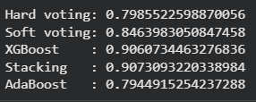
TEST SET: NEW MODELS
X_test_num = X_test.copy()
X_test_num['day'] = X_test_num['day'].astype(int)
print(accuracy(voting_hard, X_test_num, y_test_prepared))
print(accuracy(voting_soft, X_test_num, y_test_prepared))
print(accuracy(xgb_clf, X_test_num, y_test_prepared))
print(accuracy(stack_clf, X_test_num, y_test_prepared))
print(accuracy(adaboost_clf, X_test, y_test_prepared))
# also compare with the remaining algos like Bagging ,Gradient Boosting

Slide 36
Activity 1: Voting and Bagging
Dataset: Water Potability. It has 3,276 water samples with 9 numeric quality measurements (such as ph, Hardness, Sulfate, Turbidity) and the target Potability, where 1 means the water is safe to drink. Dataset link: https://www.kaggle.com/datasets/adityakadiwal/water-potability
Objective: Compare voting and bagging ensembles with single models.
Tasks:
Load the CSV. Display its shape, first 10 rows, missing values and the class distribution of Potability.
Split the data 80/20 with stratify=y and random_state=42.
ph, Sulfate and Trihalomethanes have missing values. Fill them with the training set median.
Train LogisticRegression, SVC(probability=True) and RandomForestClassifier separately (scale the data for the first two), then combine them in a VotingClassifier with hard voting and soft voting.
Train a BaggingClassifier with DecisionTreeClassifier and max_samples=0.5, using n_estimators=10 and n_estimators=100 with bootstrap=True, and then n_estimators=100 with bootstrap=False (pasting). Also train one single decision tree.
Compare all models in a table (accuracy, precision, recall, F1-score) and show the confusion matrix of the best one. Did voting or bagging beat the best single model? Explain in two sentences.

Slide 37
Activity 2: Boosting
Dataset: Telco Customer Churn. It has 7,043 customers and 21 columns, and the target Churn shows who left the company. Dataset link: https://www.kaggle.com/datasets/blastchar/telco-customer-churn
Objective: Train and tune boosting models on an imbalanced problem.
Tasks:
Load the CSV. Display its shape, first 10 rows, missing values and the distribution of Churn.
TotalCharges is stored as text and has 11 blank values. Convert it to numbers, handle the blanks, and justify your choice.
Drop customerID, encode Churn as 1 and 0, one-hot encode the categorical columns, and split 80/20 with stratify=y and random_state=42.
Train GradientBoostingClassifier, AdaBoostClassifier and XGBClassifier with default parameters and random_state=42.
Tune XGBClassifier with GridSearchCV (five-fold, scoring='f1') using n_estimators of 100 and 200, learning_rate of 0.05 and 0.1, max_depth of 3 and 5, and subsample of 0.8 and 1.0. Display the best parameters and best score.
Compare the default and tuned XGBoost on the test set (accuracy, precision, recall, F1-score, ROC-AUC) and plot the five most important features. Explain why accuracy alone is misleading here.

Slide 38
Activity 3: Stacking for Regression
Dataset: Medical Cost Personal Datasets. It has 1,338 records with age, sex, bmi, children, smoker, region and the target charges. Dataset link: https://www.kaggle.com/datasets/mirichoi0218/insurance
Objective: Test whether stacking beats each single regression model.
Tasks:
Load insurance.csv. Display its shape, first 10 rows, missing values and summary statistics of charges.
Encode sex and smoker as 0 and 1, one-hot encode region, and split 80/20 with random_state=42.
Train Ridge (with scaling), RandomForestRegressor and GradientBoostingRegressor separately.
Build a StackingRegressor with these three models, LinearRegression as final_estimator and cv=5.
Compare all four models in a table (MAE, RMSE, R²) on the test set.
Print the coefficients of the final estimator and plot actual versus predicted charges for the stack. Which base model does the stack trust most?

